Slide 1
Fast Video功能实现和应用
软件 BIOS

Slide 2
Introduction
Resource Allocate
VGA Device Init
Application

Slide 3
Introduction
Resource Allocate
VGA Device Init
Application

Slide 4
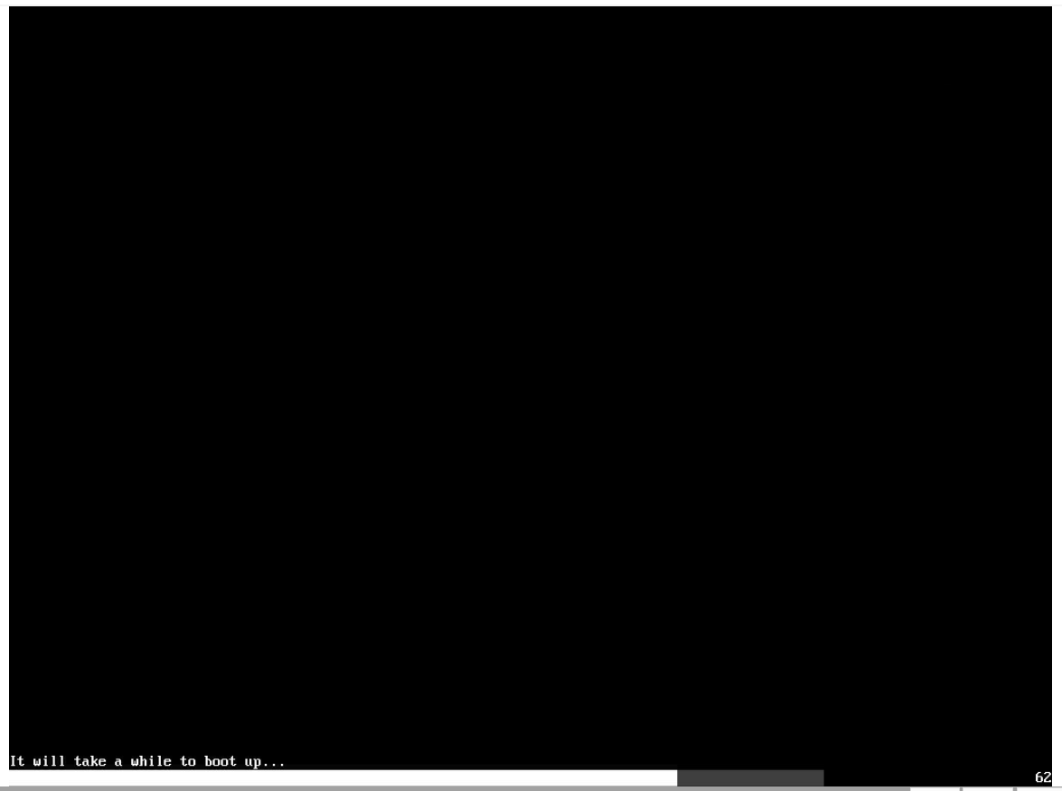
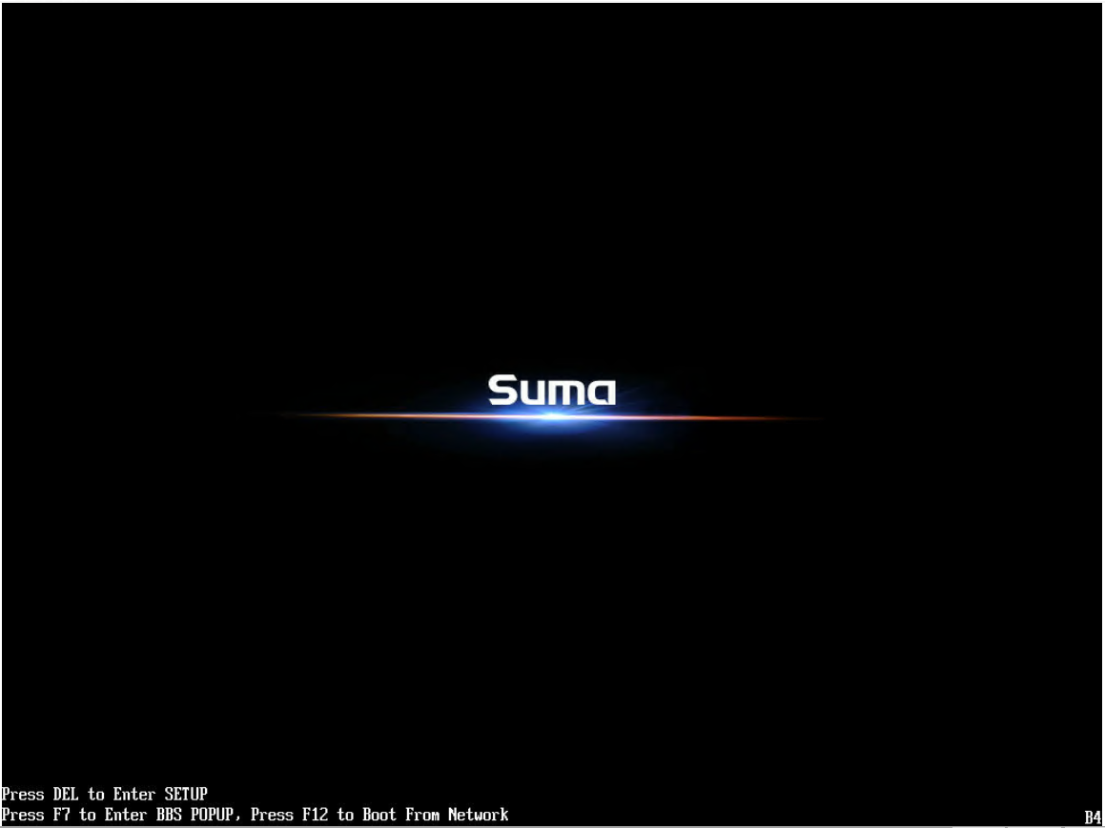
Intruction
1
2
What is Fast Video（1）？
Turn on display at an early stage (Pei Phase).

Slide 5
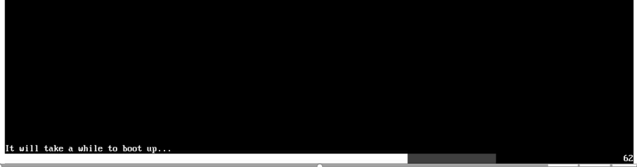
Intruction
What Fast Video do ？
Display Post Progress Bar
Display Post Code

Slide 6
Intruction
Fast Video
方便查看机器当前的Post状态--（正常情况下显示设备初始化的阶段较晚）
一种直观查看问题的Hang机点的方式--（可以通过fast video的post code判断）
也可以通过Fast Video阶段显示输出一些其他的信息

Slide 7
Introduction
Resource Allocate
VGA Device Init
Application

Slide 8
Resource Allocate
准备工作
GetCPURbBusNumAndFabricId
根据SocketNum，DieNum设置RbBusNum、FabricId
FabricGetAvailableResource-> PrefetchableMmioSizeBelow4G
PcdSet64(AmiPcdPeiPciMmioTopAddress,PciMmioStartAddress)
根据FabricResourceManagerServicesPpi获得
PciMmioStartAddress

Slide 9
Resource Allocate
EnumerateBus
InitDevices
CalculateBridgeResources
AssignBridgeResources

Slide 10
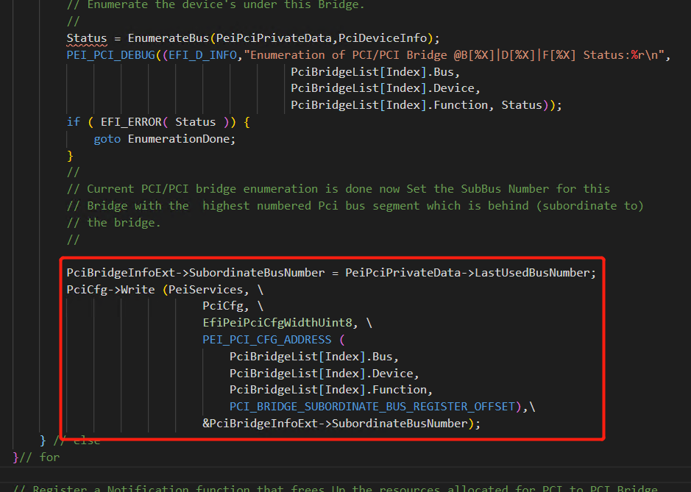
Resource Allocate
EnumerateBus
PEI阶段的枚举只会枚举显示设备，因为在会在读取设备信息的时候通过IsAllowedClassCodeDevice对设备进行筛选，只对vga设备进行枚举。
Host Bridge
Root bridge
P2P bridge
Bus号回填
Device

Slide 11
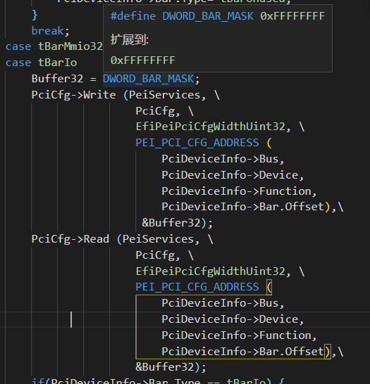
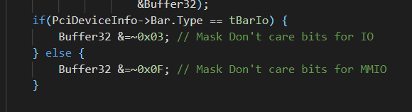
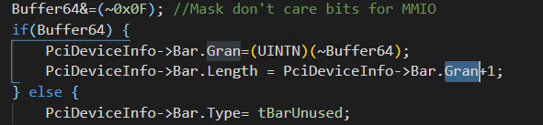
Resource Allocate
计算 32位 Base Address Register 的大小：
向Base Address Register每个bit写1， 得到32bit的数值，清除Encoding information bits(bit 1:0 for I/O, bit 3:0 for memory)，得到的数值取反 +1。

Slide 12
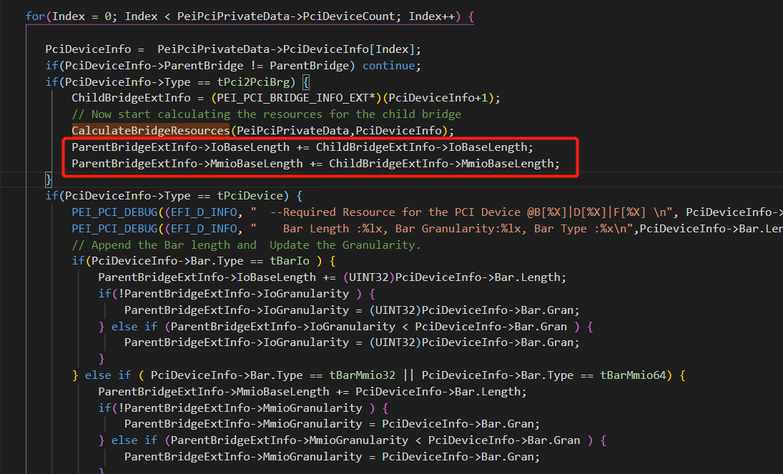
Resource Allocate
CalculateBridgeResources
Host Bridge
Bridge上的资源为桥上所有设备的资源长度相加
Root bridge
P2P bridge
Device

Slide 13
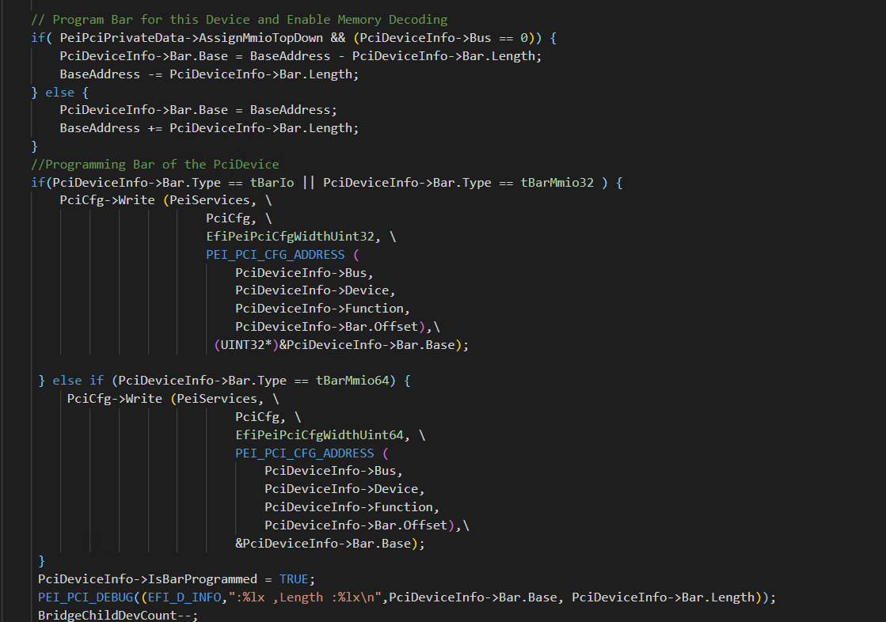
Resource Allocate

Slide 14
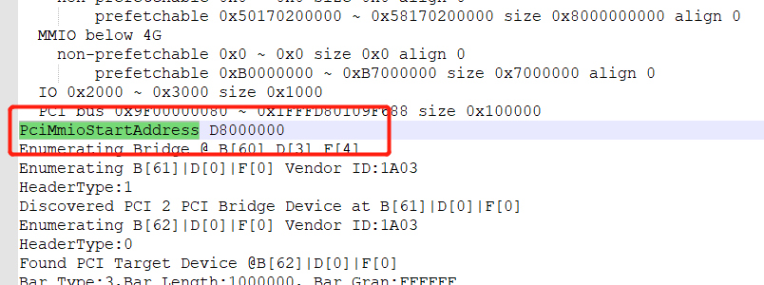
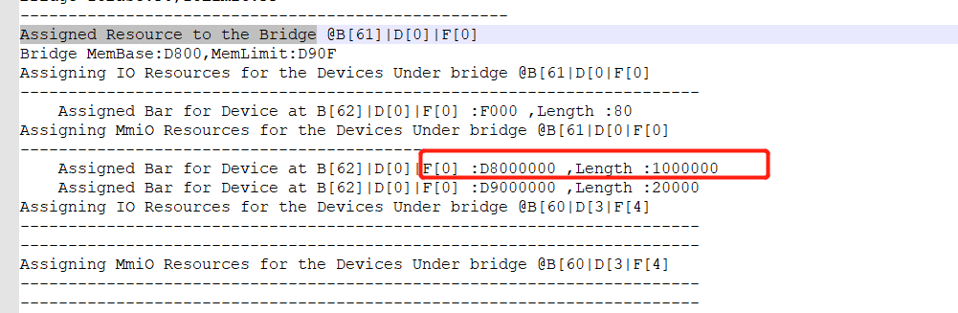
Resource Allocate

Slide 15
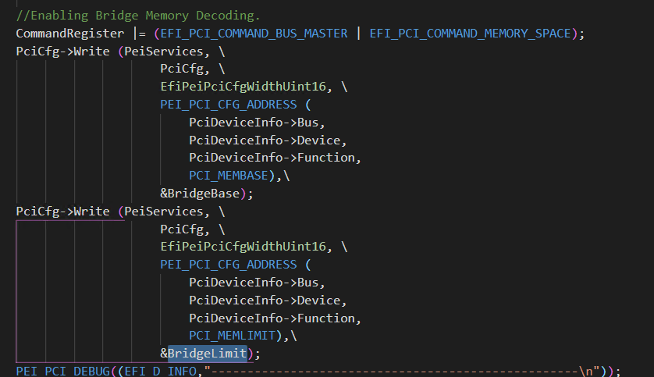
Resource Allocate
AssignBridgeResources
Host Bridge
Root bridge
P2P bridge
Device
*资源回收：在PCIBUS的第一步会将Pei阶段为BMC VGA分配的资源进行回收然后从新分配。

Slide 16
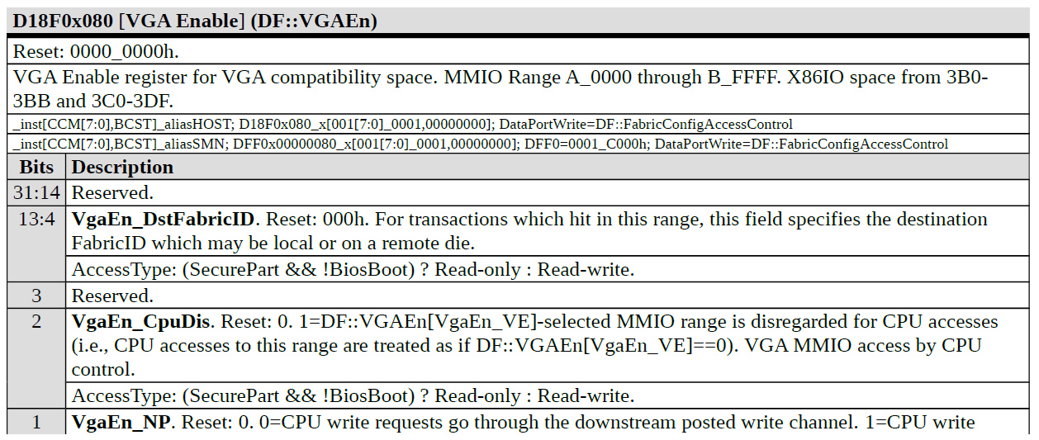
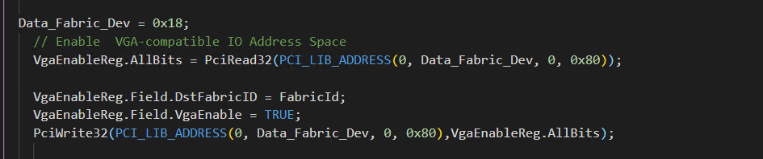
Resource Allocate
Enable VGA-compatible IO

Slide 17
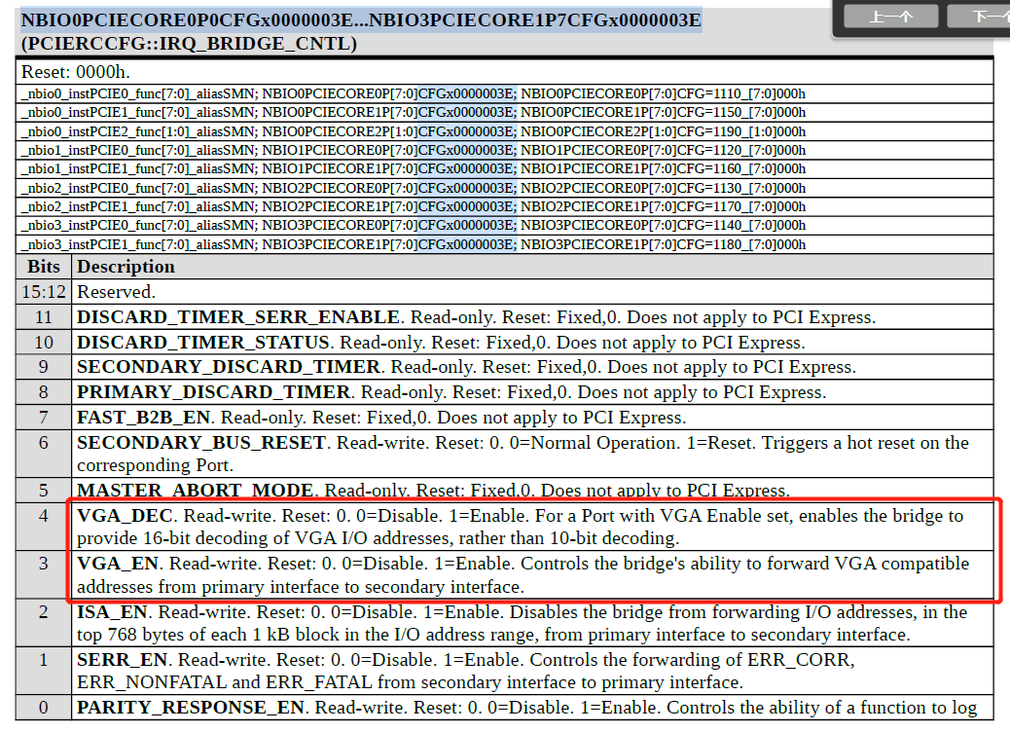
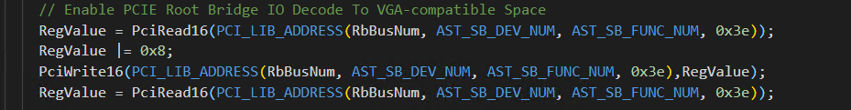
Resource Allocate
Enable PCIE Root Bridge IO Decode To VGA-compatible Space

Slide 18
Resource Allocate
GetCPURbBusNumAndFabricId
FabricGetAvailableResource-> PrefetchableMmioSizeBelow4G
PcdGetSetPciBridgeResources(get)
EnumerateBus
InitDevices
CalculateBridgeResources
FastVideoPeimEntryPoint
AssignBridgeResources
PcdGetSetPciBridgeResources(set)
Enable VGA-compatible IO
Enable PCIE Root Bridge IO Decode To VGA-compatible Space
GetDevInfo
SetFrameBufferAddress
InitVGA
InitVGA_HW
SetMode
FBBltImage

Slide 19
Resource Allocate
Read->VendorId
CheckPreEnumerationInitFunctionHook
Read->HeaderType
EnumerateBus(Bridge)
Write->PciBridgeInfoExt
EnumerateBus(Device’s under this Bridge)
Write->PciBridgeInfoExt.SubordinateBusNumber
ASTInitFunc
ASTInitBridgeFunc
CheckPreEnumerationInitFunctionHook
AmdBridgeInitFunc
AmdBridgeInitFunc
Read->RevisionId
CheckPreEnumerationInitFunctionHook
EnumerateBus(Device)
IsAllowedClassCodeDevice
QueryPciDeviceResources

Slide 20
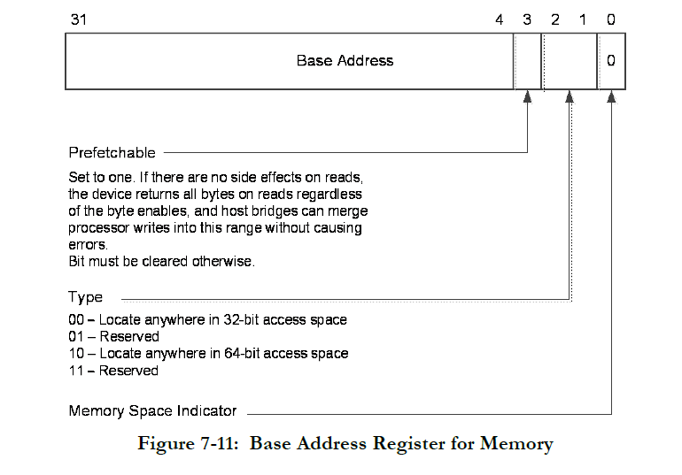
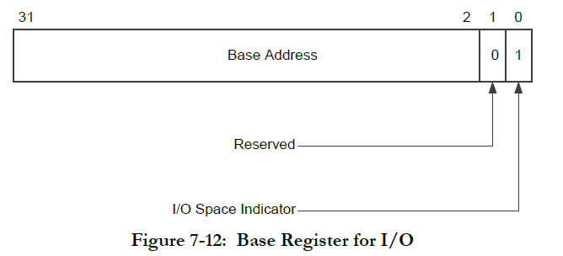
Resource Allocate
Read->Bar.Offset Buffer32 & 1
check what type of resource
QueryPciDeviceResources
PciCfg->Write->Bar.Offset
PciCfg->Read->Bar.Offset
Get Length
CalculateBridgeResources

Slide 21
Introduction
Resource Allocate
VGA Device Init
Application

Slide 22
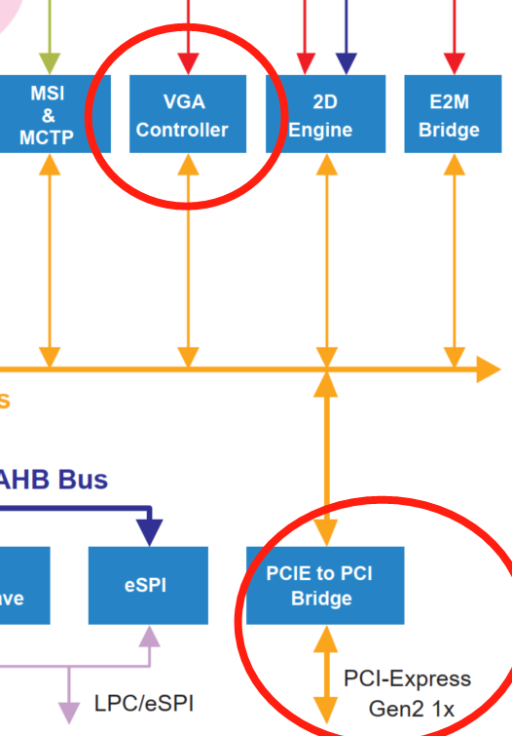
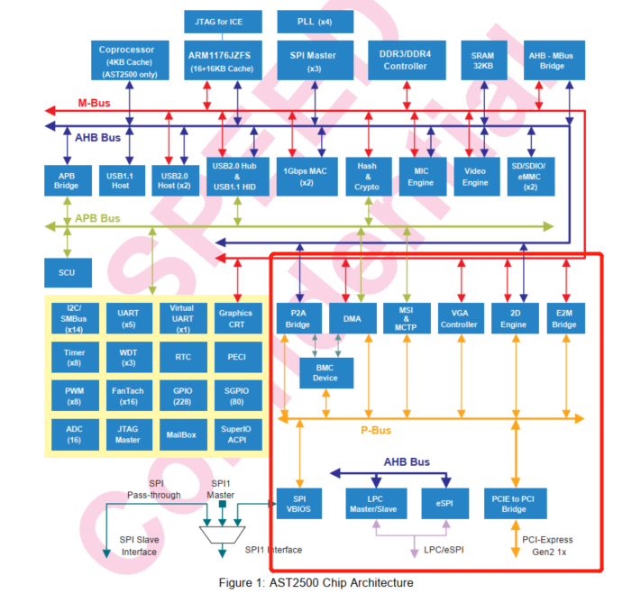
VGA Device Init

Slide 23
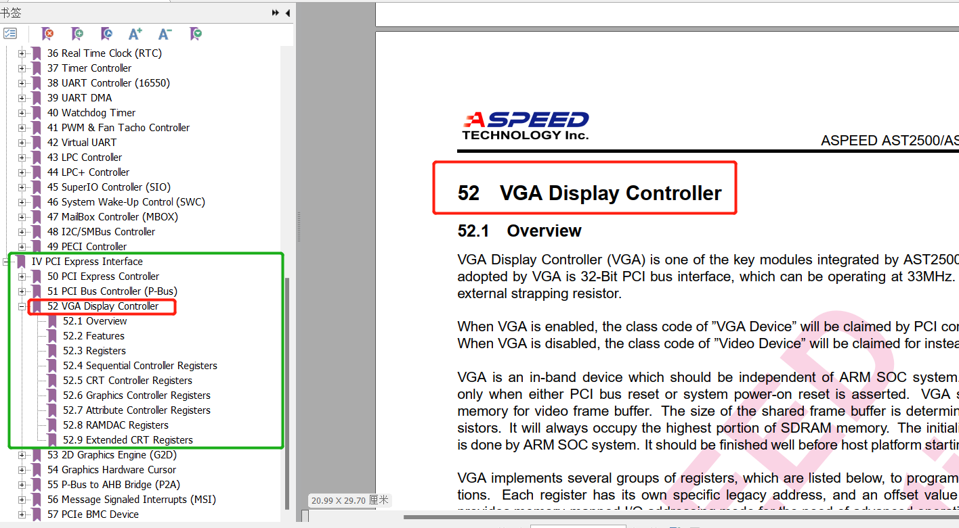
VGA Device Init

Slide 24
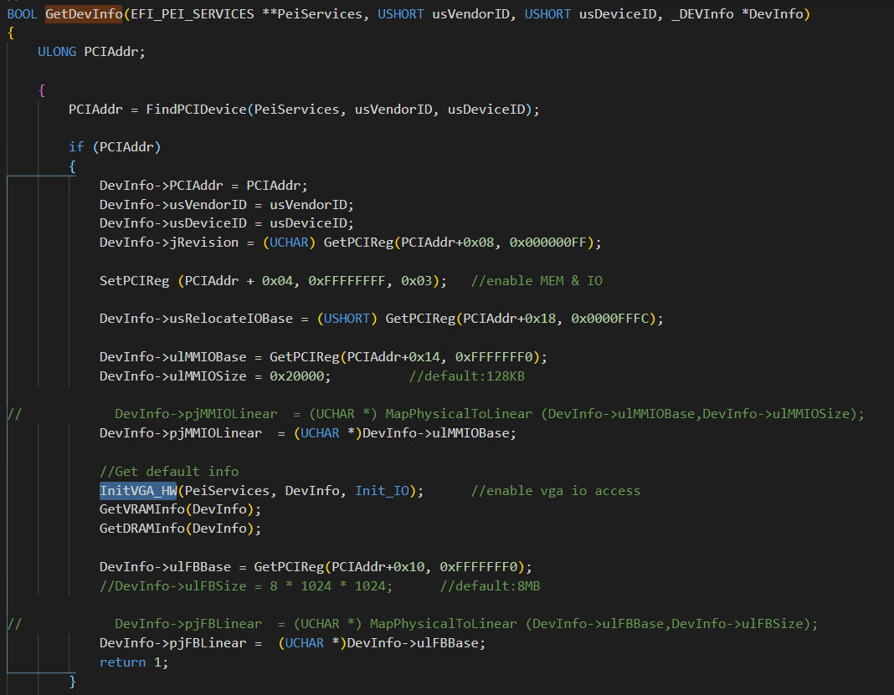
VGA Device Init
GetDevInfo
根据VID DID查找设备的配置空间，读取usRelocateIOBase、ulMMIOBase、ulMMIOSize、ulFBBase
并在InitVGA_HW中enable_vga

Slide 25
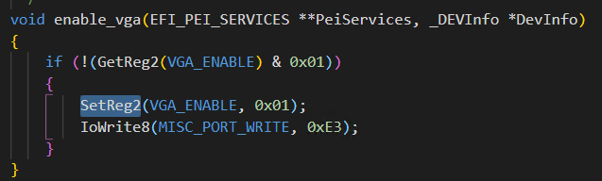
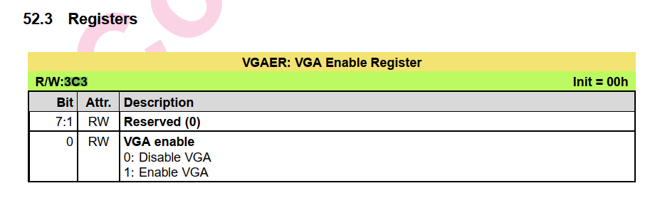
VGA Device Init
enable_vga

Slide 26

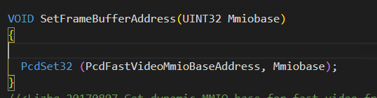
VGA Device Init
SetFrameBufferAddress
将ulFBBase的值赋给PCD变量，便于在后面使用时使用

Slide 27
VGA Device Init
FindPCIDevice
GetInfo(IOBase/MMIOBase)&Set MMIOSize
enable_vga
GetDevInfo
InitVGA_HW (enable vga io access)
open_key
GetVRAMInfo
PLL_ Init
GetDRAMInfo
InitVGA
SetFrameBufferAddress
InitVGA_HW (Mem)
SetMode
FBBltImage

Slide 28
Introduction
Resource Allocate
VGA Device Init
Application

Slide 29
Application
PROGRESS_CODE(DXE_PCI_BUS_BEGIN);
LibReportStatusCode(EFI_PROGRESS_CODE, Code, 0, NULL, NULL)
StatusCodePtr->ReportStatusCode(Type,Value,Instance,CallerId,Data);
AmiReportStatusCode
SimpleStatusReport(PeiServices,Type,Value);
SimpleList
CheckPointStatus
CheckpointStatusReport
CheckpointList（Port80Checkpoint,ConOutCheckpoint,VGACheckPoint）
VGACheckPoint

Slide 30
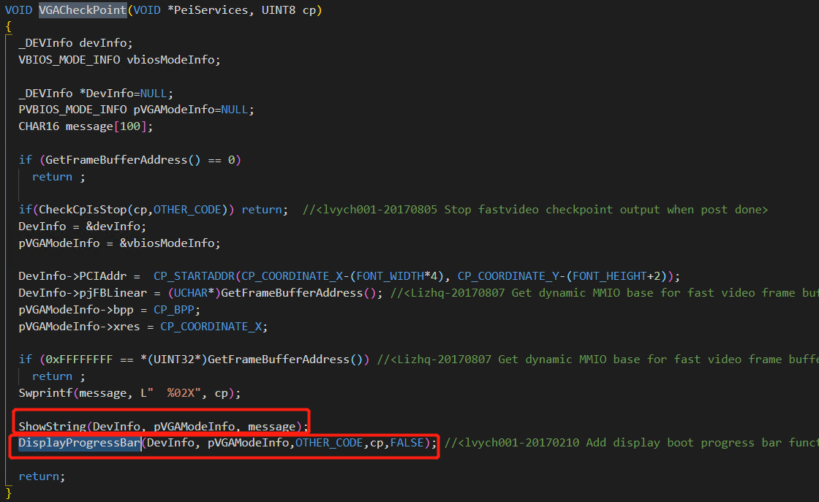
Application

Slide 31

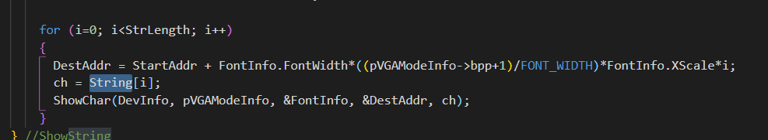
Application
Display Postcode

Slide 32
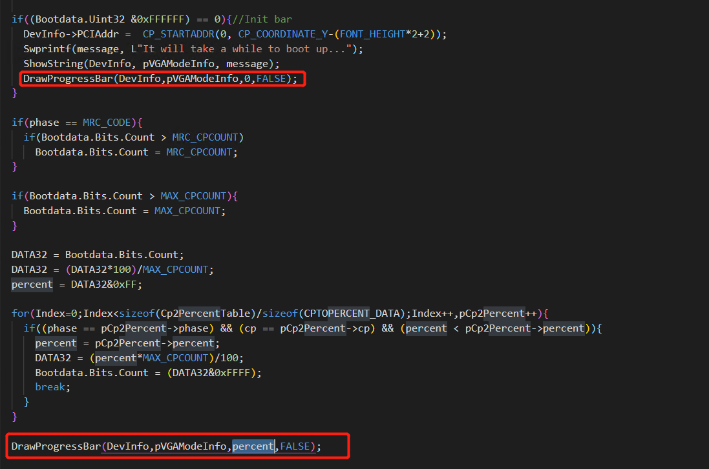
Application
Display ProgressBar

Slide 33
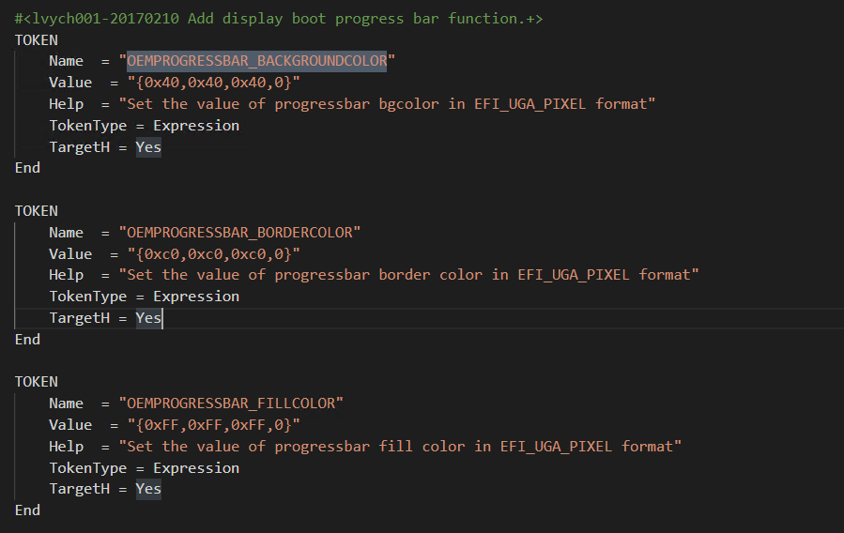

Application

Slide 34
Q&A

